Slide 1
AERIAL DRONES Missions With 5G And Starlink Support
António Almeida, Francisco Ribeiro, Guilherme Vieira, Miguel Vila, Tiago Rodrigues
Notes:
Vila

Slide 2
TABLE OF CONTENTS
01
02
03
04
05
06
07
08
09
PROBLEM
GOALS
EXPECTED RESULTS
RELATED WORK
CALENDAR
TASKS
COMMUNICATION
ASSIGNMENTS
WEBSITE
Notes:
Vila

Slide 3
01
PROBLEM
Notes:
Vila

Slide 4
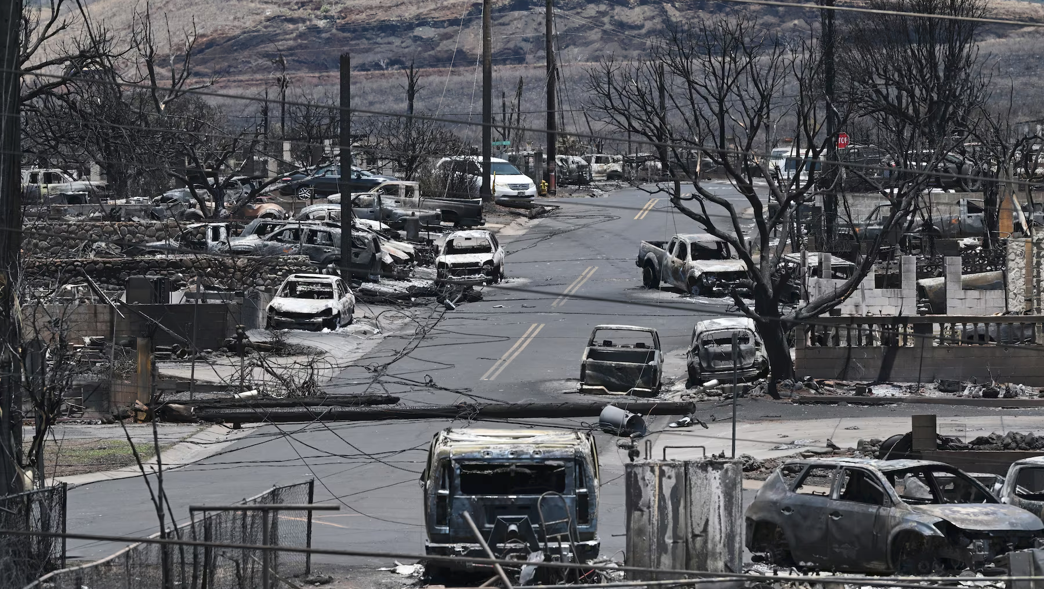
"On the field, the situation was still chaotic, with authorities trying to evacuate people from the most affected areas, without electricity and
with the complete disruption of the telecommunications network.”
"Incêndios no Havai: 'Não tínhamos como contactar o mundo exterior'", SIC Notícias, 10 August 2023. Translated by Miguel Vila.
Notes:
Vila

Slide 5
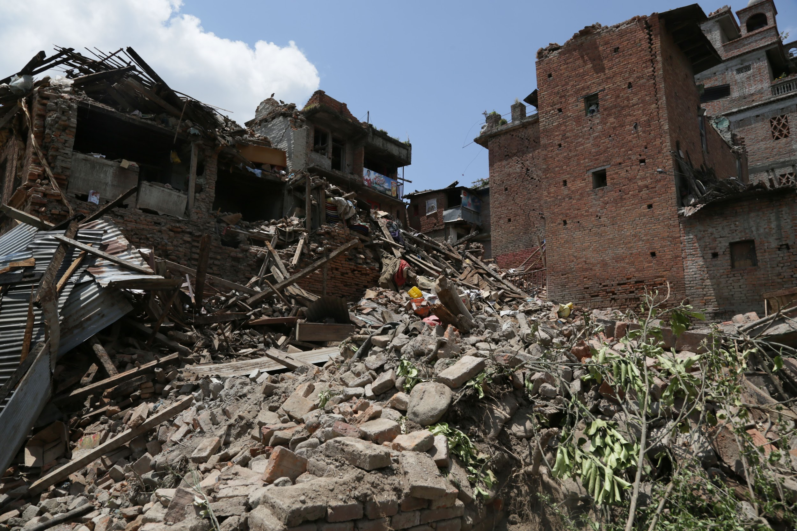
"The paths were damaged or blocked by landslides, and communications went down, preventing us from contacting the local branches of the Red Cross for accurate information.”
"Destruição impede saber situação da área do epicentro de terremoto do Nepal", UOL, 26 April 2015.
Translated by Miguel Vila.
Notes:
Vila

Slide 6
02
GOALS
Notes:
Vieira

Slide 7
GOALS
PRIMARY
Make a drone network that can share 5G or, in case of a missing connection, share a Starlink connection using 5G
SECONDARY
Make the mission planner platform more dynamic
Make a Live Feed possible, to use in the tourism area
Notes:
Vieira

Slide 8
03
EXPECTED RESULTS
Notes:
Vieira

Slide 9
EXPECTED RESULTS
Flying network
Computer Vision
Create an autonomous system that can provide 5G communication on a designated area through the mission planner platform.
Use a computer algorithm which can help navigate and dodge obstacles present between the drone and his destination.
Notes:
Vieira

Slide 10
04
RELATED WORK
Notes:
António

Slide 11
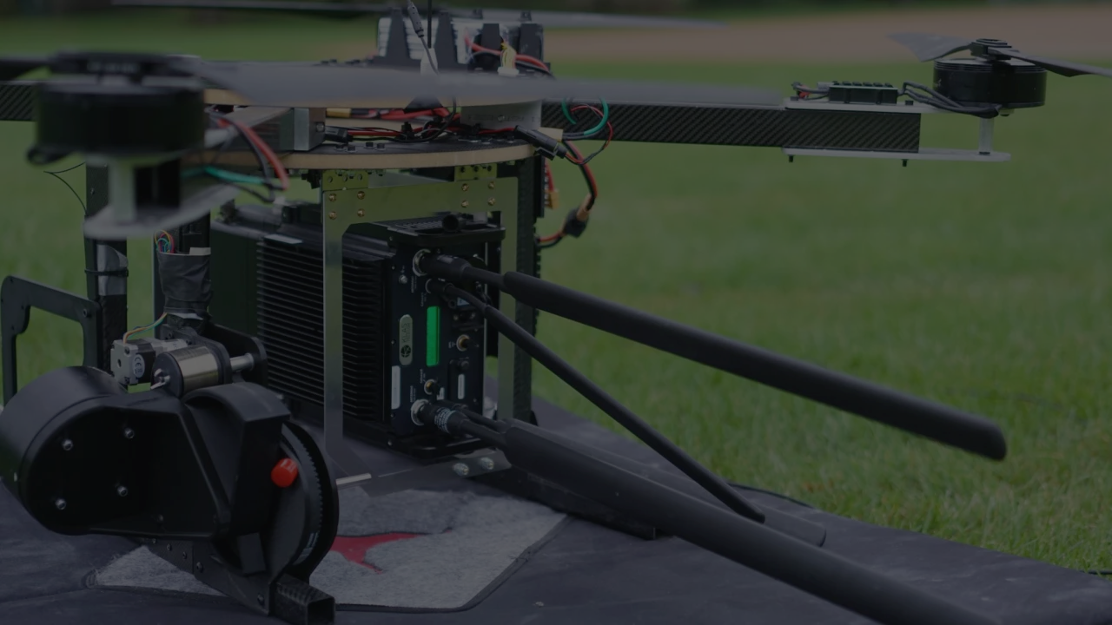
WHAT SHOULD YOU KNOW FIRST
“If we took the drones that we were building … that were very powerful, they could fly for a very, very long time … and basically stuck 4G routers on them, we could bring the internet wherever we want it”
Rahul Tiwari
Notes:
António

Slide 12
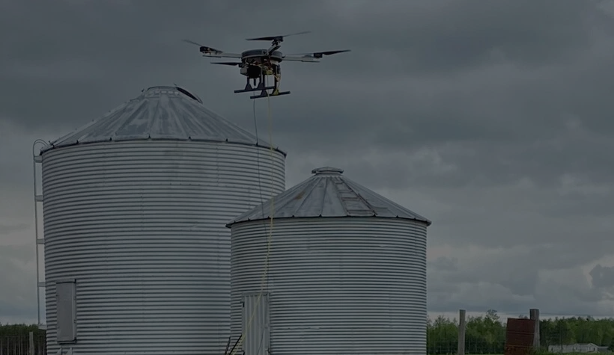
WHAT SHOULD YOU KNOW FIRST
"This isn't the Holy Grail of solutions that, boom, just solves it and now rural people will have internet … But I do think it has a spot, and maybe it will point us in a direction of a better long-term solution for these really hard to meet areas."
Foster
Notes:
António

Slide 13

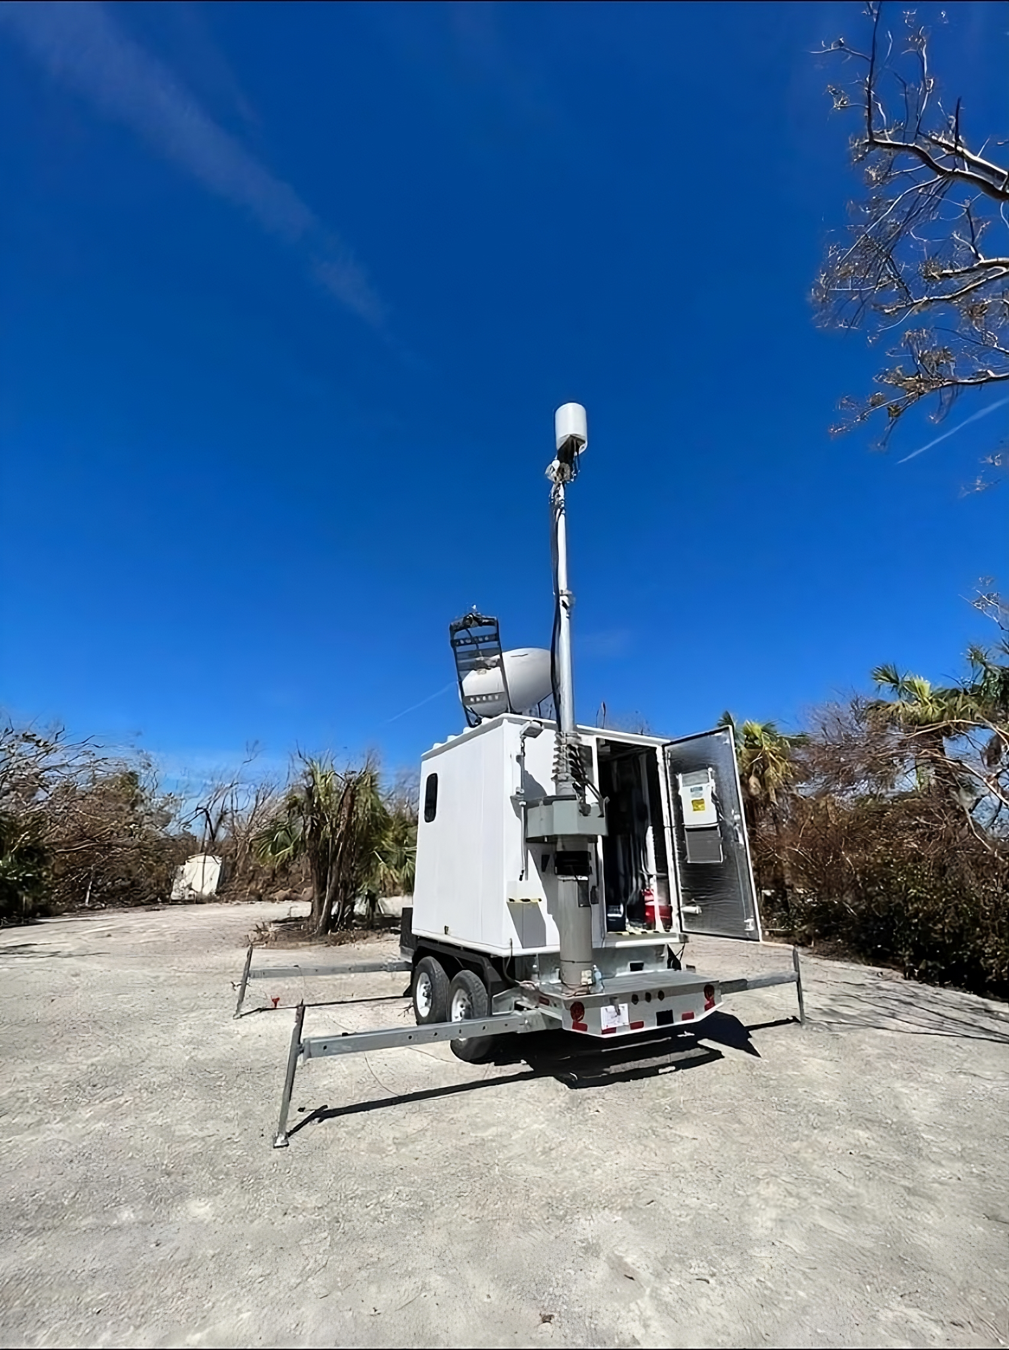
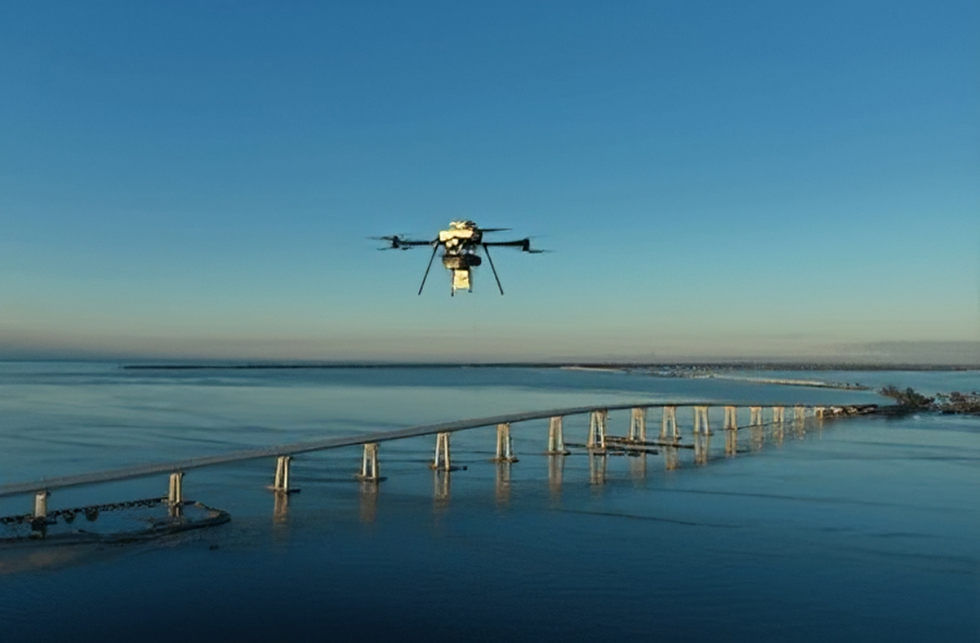
WHAT SHOULD YOU KNOW FIRST
“Verizon has launched a tethered drone outfitted with a cellular node (a flying cell site) that is providing cellular coverage from the air to support search and rescue teams and first responders on the ground. The drone provides coverage for an approximate 5-7 mile radius, and can fly for up to 1,000 hours.” - Miriam McNabb
Notes:
António

Slide 14
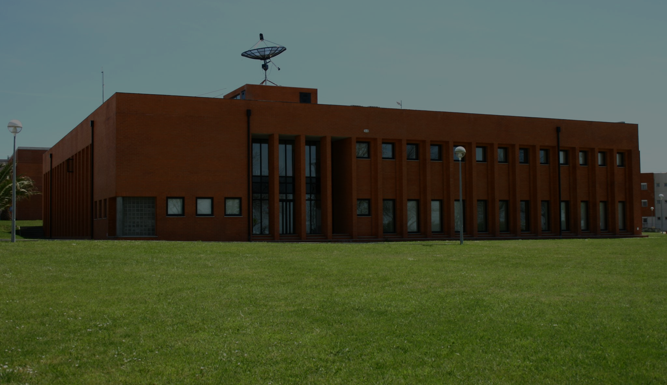
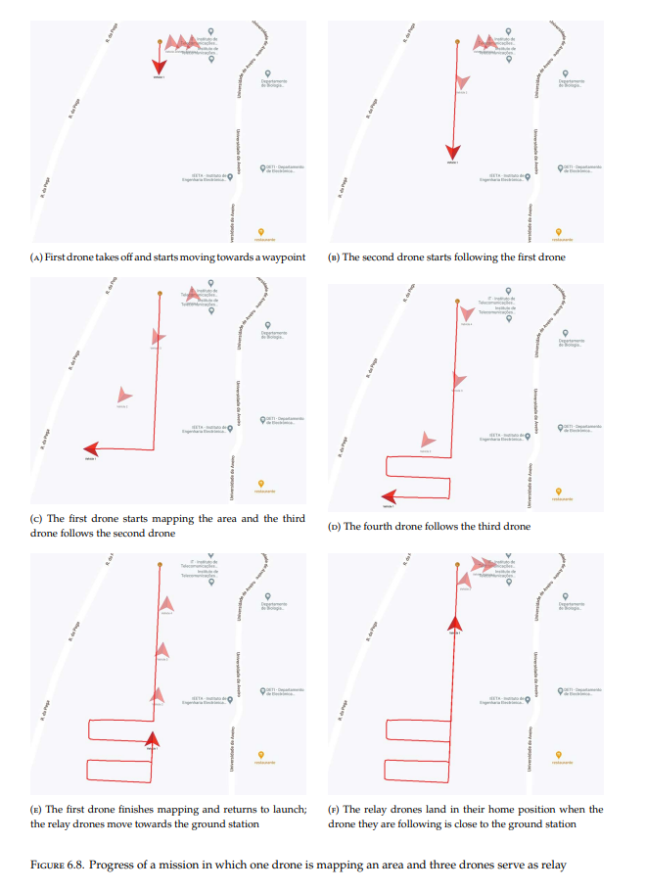
WHAT SHOULD YOU KNOW FIRST
“The framework that was designed and evaluated in this work overcomes those limitations and offers flexible mission planning, with non-linear missions that can change the course of a drone at any time during its sequence of actions while being able to request data from its own sensors and reacting to that data.”
“Collision avoidance, either by preventing crossing other drone’s path or colliding with another object, is a crucial feature that needs to exist in such a system.”
Ana Margarida Oliveira da Costa e Silva
Notes:
António

Slide 15
05
CALENDAR
Notes:
António

Slide 16
September
October
November
December
January
February
March
April
May
State of the Art
Requirements
Architecture
Development
Demonstrator
Management
Documentation & Dissemination
M1
M2
M3
M4
Notes:
António

Slide 17
06
TASKS
Notes:
Francisco

Slide 18

TASK LIST
STATE OF THE ART | Organize what is already created | Search similar projects
REQUIREMENTS | Hardware | Background work in the drone missions | Current 5G deployment in drones
ARCHITECTURE | Define network architecture | Define obstacle avoidance service architecture | Select technology and ML models for obstacle detection
DEVELOPMENT | 5G connection and Starlink | Monocular Depth Algorithm | Adaptation of the current mission planner platform
DEMONSTRATOR | Drone flying while sharing a network connection | Avoid obstacles while flying | Live Feed*
MANAGEMENT | Split the team in groups | Distribute in equal parts for each group member
DOCUMENTATION & DISSEMINATION | Milestones | Final presentation | Students@deti
*optional
Notes:
Francisco (3 primeiras linhas) Tiago (restante)

Slide 19
07
COMMUNICATION
Notes:
Tiago

Slide 20



COMMUNICATION
Notes:
Tiago

Slide 21
08
ASSIGNMENTS
Notes:
Francisco

Slide 22
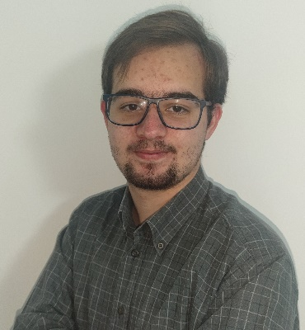
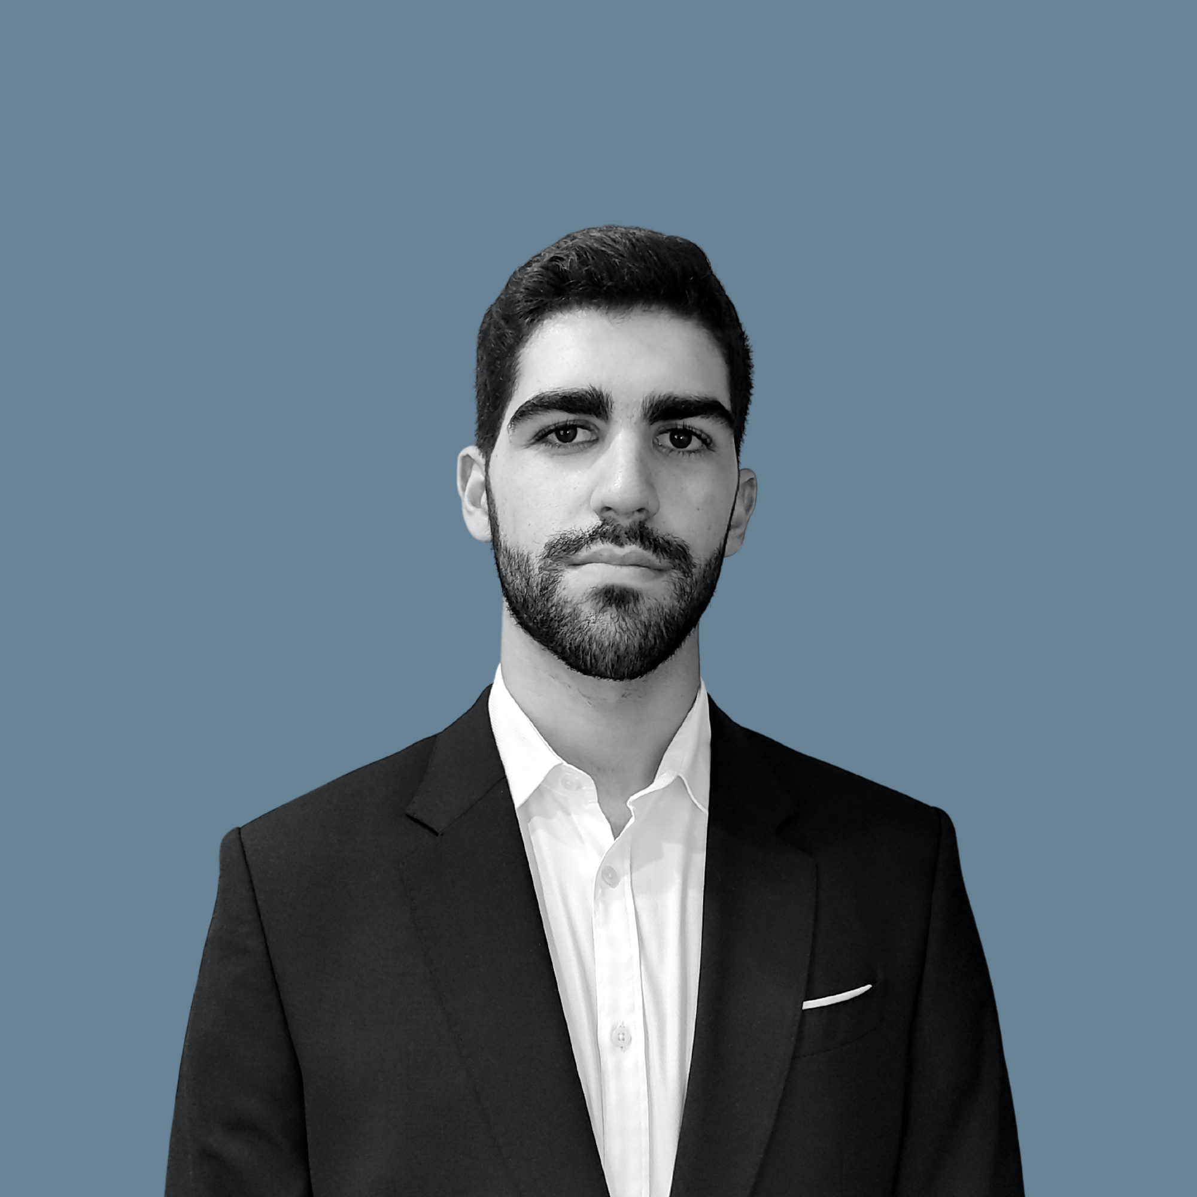
NETWORK TEAM
Francisco Ribeiro
Miguel Vila
Notes:
Francisco

Slide 23
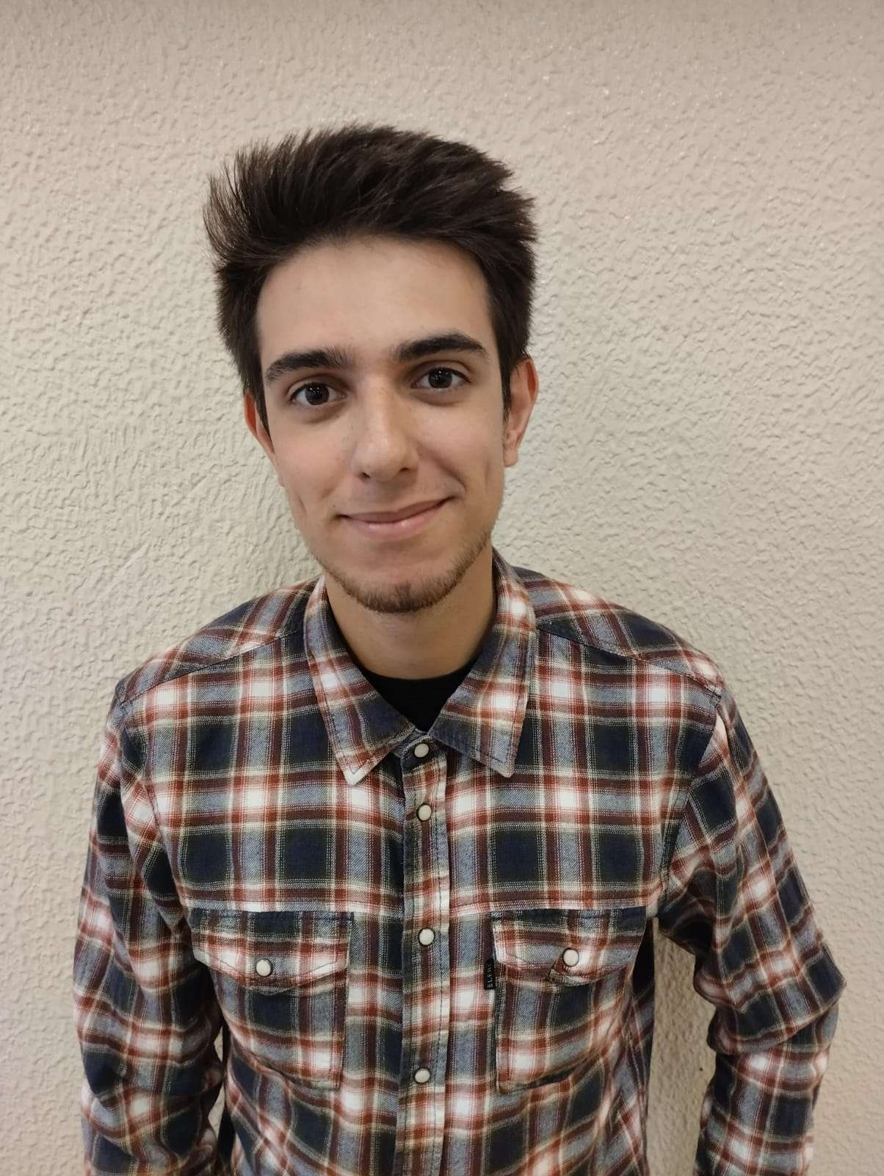
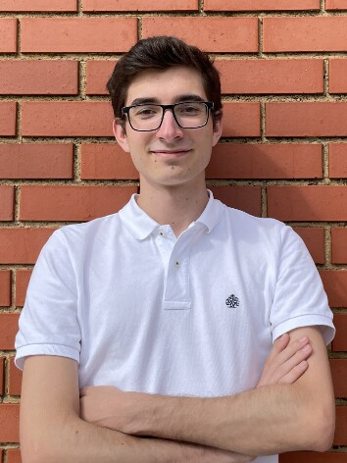
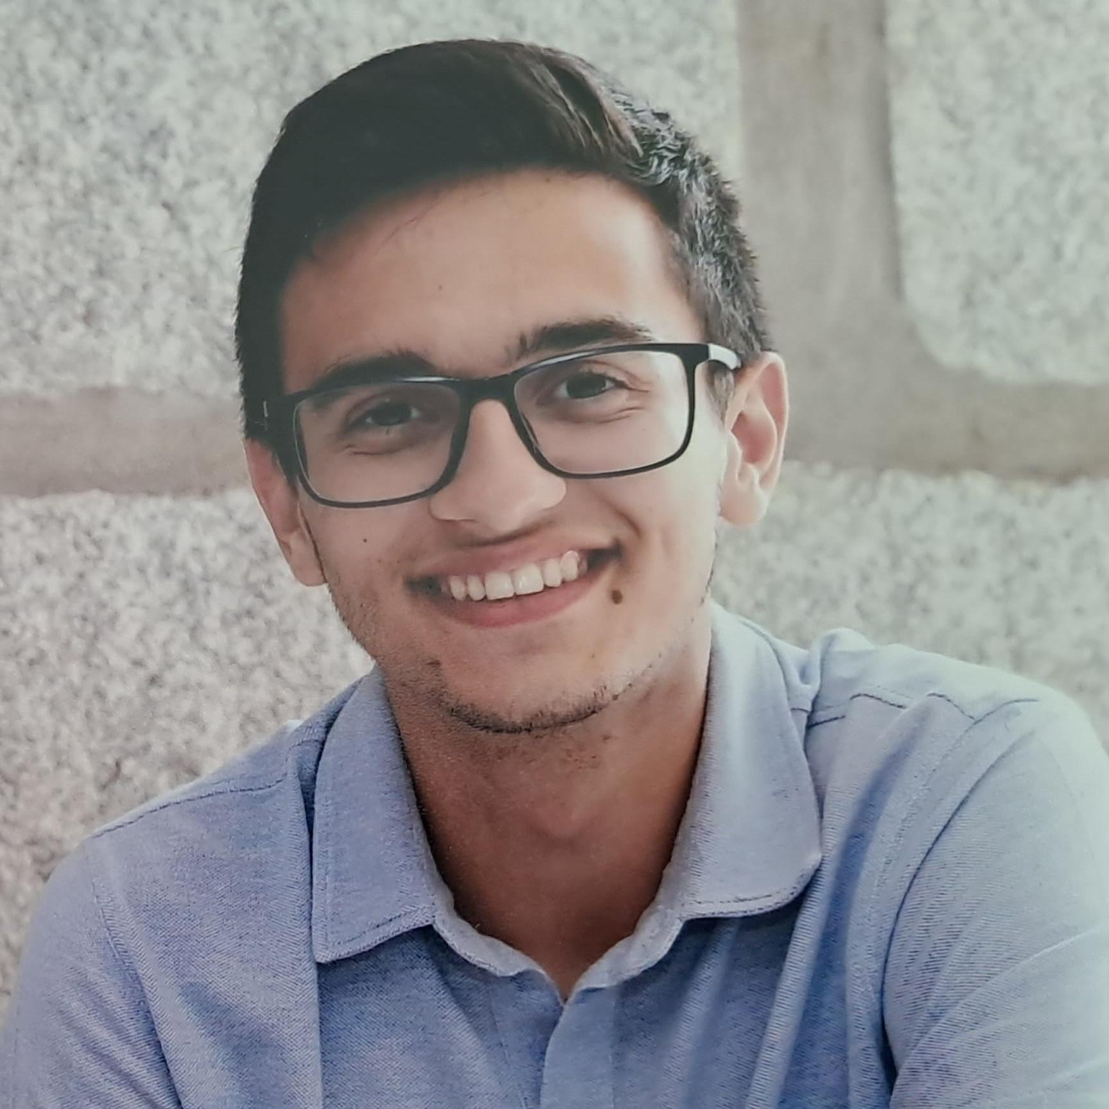
COMPUTER VISION TEAM
António Almeida
Guilherme Vieira
Tiago Rodrigues
Notes:
Francisco

Slide 24
MISSION PLANNER TEAM
António Almeida
Francisco Ribeiro
Tiago Rodrigues
Notes:
Francisco

Slide 25
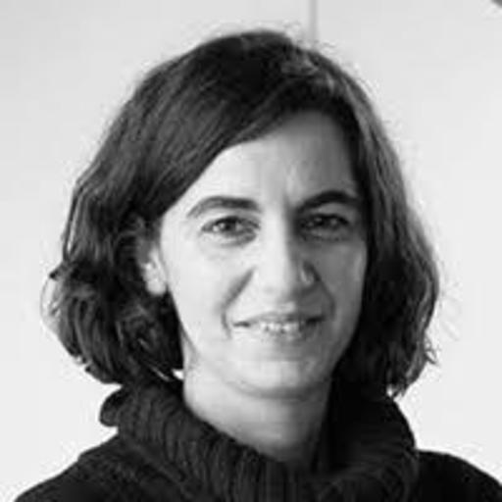


ORIENTATION TEAM
Susana Sargento
Pedro Rito
Miguel Luís
Notes:
Francisco

Slide 26


ORIENTATION TEAM
Joaquim Ramos
Pedro Valente
Notes:
Francisco

Slide 27
09
WEBSITE
https://5g-dove.github.io/
Notes:
Vieira

Slide 28
THANKS!
DO YOU HAVE ANY QUESTIONS?
Notes:
Vila

